Slide 1
What kinds of data can be mined????

Slide 2
As a general technology, data mining can be applied to any kind of data as long as the data are meaningful for a target application.
The most basic forms of data for mining applications are: database data , data warehouse data, and transactional data.
Data mining can also be applied to other forms of data repositories (e.g., data streams, ordered/sequence data, graph or networked data, spatial data, text data, multimedia data, and the WWW).
However, algorithms and approaches may differ when applied to different types of data.

Slide 3
Flat files
Flat files are actually the most common data source for data mining, especially at research level.
Flat files are simple data files in text or binary format.
The data in these files can be transactions, time series data, scientific measurements etc.

Slide 4
Relational databases
Data mining algorithms using relational databases can be more versatile than data mining algorithms specifically written for flat files.
Data mining can benefit from SQL for data selection.
Relational databases are one of the most commonly available and richest information repositories

Slide 5
Data warehouse
A data warehouse is a repository of information collected from multiple sources, stored under a unified schema, and usually residing at a single site.
Data warehouses are constructed via a process of data cleaning, data integration, data transformation, data loading, and periodic data refreshing.
To facilitate decision making, the data in a data warehouse are organized around major subjects (e.g., customer, item, supplier, and activity).
The data are stored to provide information from a historical perspective, such as in the past 6 to 12 months, and are typically summarized.

Slide 6
Data warehouse Cond……
A data warehouse is usually modeled by a multidimensional data structure, called a data cube.
each dimension corresponds to an attribute or a set of attributes in the schema, and each cell stores the value of some aggregate measure such as count or sum (sales _amount).

Slide 7
Transactional Data
A transaction database is a set of records representing transactions, each with a time stamp, an identifier and s et of items.
Associated with transaction files could also be descriptive data for the items.
Since relational databases do not allow nested tables, transactions are usually stored in flat files or stored in two normalized transaction tables, one for transaction and one for the transaction items.
The typical data mining analysis on such data is called the market basket analysis or association rules in which associations between items occurring or in sequence.

Slide 8
Multimedia databases
It includes video, images, audio and text media.
They can be stored on object oriented databases or simply on a file system.
multimedia is characterized by high dimensionality, which makes data mining even more challenging.
It may require computer vision, computer graphics, image interpretation and natural language processing.

Slide 9
Spatial Databases
In addition to usual data , it stores geographical data.
Data like maps, and global regional positioning.
It present new challenges to data mining algorithms.

Slide 10
Time series data
It contains time related data.
Like stock market data and logged activities.
Data mining in such databases includes the study of trends and correlations between evaluations of different variables as well as a prediction of trends.

Slide 11
World Wide data
It is the most heterogeneous and dynamic data repository.
Data in the WWW is organized in interconnected documents.
These documents can be audio, video, text etc.
It is also called a web mining.

Slide 12
Types of data

Slide 13
INTERNAL DATA
Most organizations build their first data warehouse efforts on data whose source is existing systems (that is, on data internal to the corporation).
In almost every case, this data can be termed internal, structured data.
The data comes internally from the corporation and has been already shaped into a regularly occurring format.

Slide 14
EXTERNAL DATA
A data that is not to be generated from the corporation’s own systems is called the External Data.
The data warehouse is the ideal place to store external data.
When this type of data enters the corporation in an undisciplined fashion, the identity of the source of the data is lost, and there is no coordination whatsoever in the orderly use of the data.

Slide 15
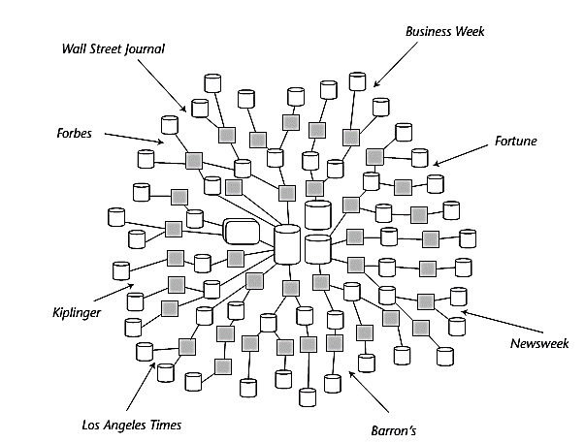

Slide 16
EXTERNAL DATA
There are two basic types of external data:
Records of external data collected by some source (such as a drug store, a supermarket, and so forth).
External data from random reports, articles, and other sources.
Some typical sources of interesting and useful external data include the following: Marketing comparison and analysis reports, Sales analysis and comparison reports etc.

Slide 17
EXTERNAL DATA
Several issues relate to the use and storage of external data in the data warehouse:
Unlike internally appearing data, there is no real fixed pattern of appearance for external data and constant monitoring must be set up to ensure that the right external data is captured.
The second problem with external data is that it is Totally Undisciplined. To be useful, and for placement in the warehouse, a certain amount of reformatting and structuring of external data is needed to transform it into an internally acceptable and usable form in the data warehouse.

Slide 18
EXTERNAL DATA
In some cases, the level of granularity of the external data will not match that of the internal systems of the corporation.
The next factor that makes external data hard to capture and use is its unpredictability. External data may come from practically any source at almost any time.

Slide 19
Storing EXTERNAL DATA
External data can actually be stored in the data warehouse if it is convenient and cost-effective to do so.
But in many cases, it will not be possible or economical to store all external data in the data warehouse. Instead, an entry is made in the metadata of the warehouse describing where the actual body of external data can be found.
The external data is then stored elsewhere, where it is convenient.

Slide 20
reference DATA
The another type of data belongs in the data warehouse is reference data.
The reference data tables, stored in addition to basic data in data mart/ data warehouse help and enable the end users of the data mart/ data warehouse to relate the data to its expanded version.
Reference data is particularly applicable to the data warehouse environment because it helps reduce the volume of data significantly.

Slide 21
reference DATA
There are many design techniques for the management of reference data.
The first design option, where a snapshot of an entire reference table is taken in every six months. This approach is quite simple and at first glance appears to make sense. But the approach is logically incomplete.
For example, suppose some activity had occurred to the reference table on March 15. Say a new entry, ddw, was added, and then on May 10 the entry for ddw was deleted. Taking a snapshot every six months would not capture the activity that transpired from March 15 to May 10.

Slide 22
reference DATA
A second approach, at some starting point, a snapshot is made of a reference table. Throughout the year, all the activities against the reference table are collected. To determine the status of a given entry to the reference table at a moment in time, the activity is reconstituted against the reference table. In such a manner, logical completeness of the table can be reconstructed for any moment in time.

